Slide 1
Optimal broadcasting on incomplete star graph interconnection networks
Tzung-Shi Chen, Nen-Chung Wang
Journal of Systems Architecture 51 (2005) 143–150
Presenter: Chiao-Wei Chiu
Date: Sept. 19, 2007

Slide 2
Abstract
Broadcasting is an important collective communication operation in many applications which use parallel computing. In this paper, we focus on designing broadcasting algorithms for general incomplete star graphs. We propose two optimal one-to-all broadcasting algorithms for incomplete star graphs with a single-port communication model. An incomplete star graph with N nodes, where (n - 1)! < N < n!, is a subgraph of an n-dimensional star graph. The first scheme is single-message one-to-all broadcasting that takes O( n log n) steps. The second one is multi-message one-to-all broadcasting that takes O( n log n + m) steps.

Slide 3
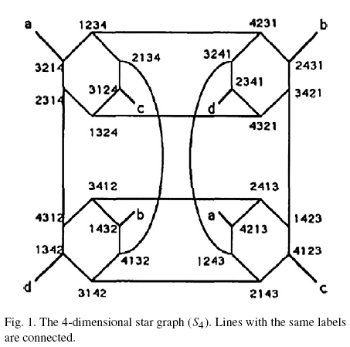
Star graph
Any two nodes v_{p} and v_{q} are connected by an undirected edge if and only if the permutation of the node v_{q} can be obtained from the corresponding permutation of v_{p} by interchanging the symbol p_{i} of v_{p} and the symbol p₁ of v_{p} for 2 ≦ i ≦ n.

Slide 4
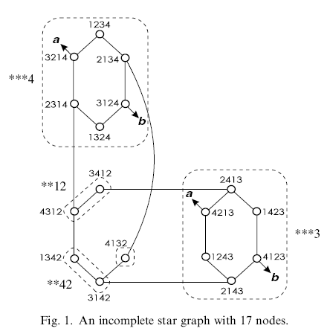
Incomplete star graph
Assume that N is the total number of nodes in an incomplete star graph, where (n-1)! < N < n! for some integer n.

Slide 5
The k-dimensional substar
The stars with the same dimension k are classified to form a class C^{k}
For example, in Fig. 1.
C³ = {***4, ***3},
C² = {**12, **42}
C¹ = {4132}
The two substars **12 and **42 are adjacent in the same class C². The two substars **42 and 4132 are adjacent in different classes.
We use the notation *^{k}c_{k+1}… c_{n} to denote the k-dimensional substar

Slide 6
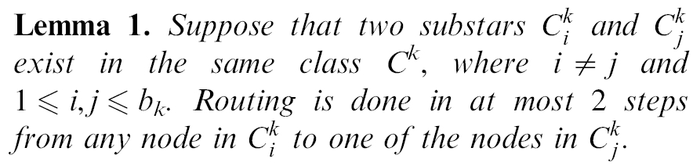
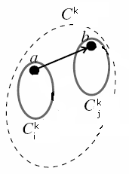
Lemma 1.
xx…acc…c → bx…acc…c → ax…bcc…c
in *^{k}acc…c
in *^{k}bcc…c

Slide 7
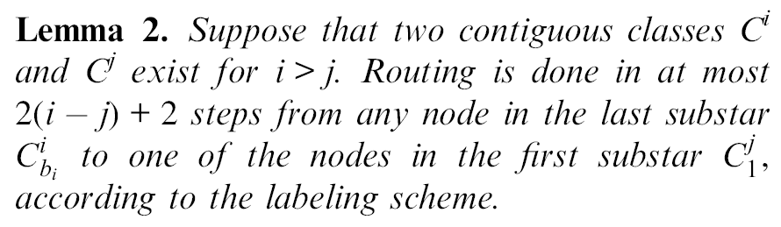
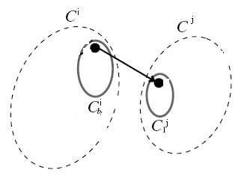
Lemma 2.
xx…xcc…c → dxx…xcc…c → xx…xdcc…c
→ xx…xddcc…c
…
→ xx…xdd…dcc…c
→ xx…xdd…dac…c

Slide 8
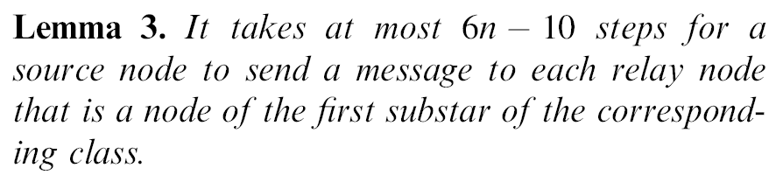
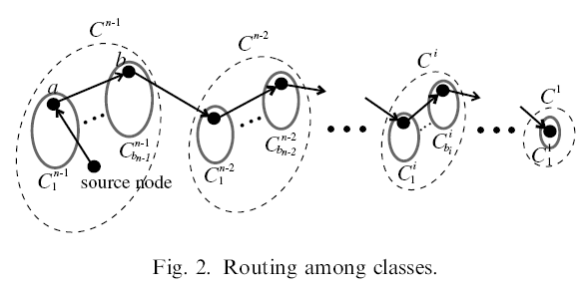

Lemma 3.

Slide 9
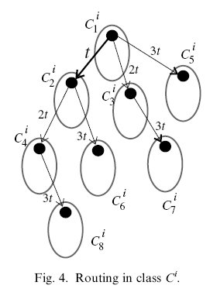
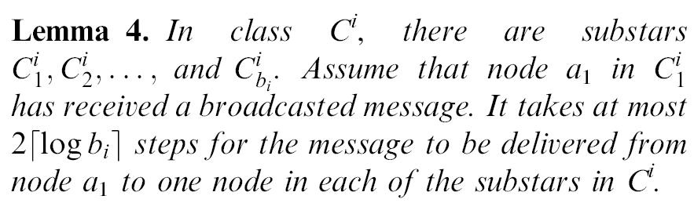
Lemma 4.

Slide 10
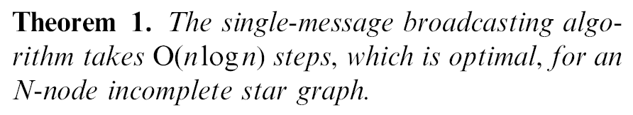
Theorem 1.
We can perform broadcasting on these substars in parallel by using the proposed algorithm in [13] to accomplish this operation.
For one-to-all broadcasting, the lower bound of time complexity is O(logN) = O(nlogn), where (n-1)! < N < n!.
O(6n) + O(log(n - 1)) + O((n - 1) log(n - 1)) = O(nlogn),

Slide 11
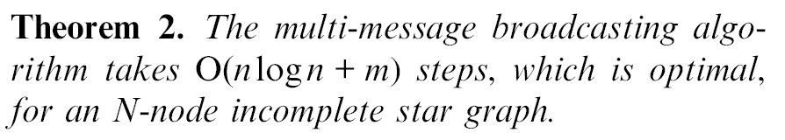
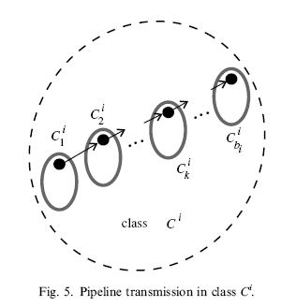
Theorem 2.
O( n + m) + O( n + m)
+ O( (n - 1)log (n - 1) +m)
= O( n log n + m),

